Slide 1


Effects of Unsteady Motion on Separation and Separation Control
Sponsor: U.S. Air Force Office of Scientific Research (FA9550-14-1-0184)
Michael Nathanson
Undergraduate
Aerospace and Mechanical Engineering
University of Arizona, Tucson, AZ
Arizona Space Grant Statewide Symposium
Tucson, Arizona
April 14th, 2018

Slide 2
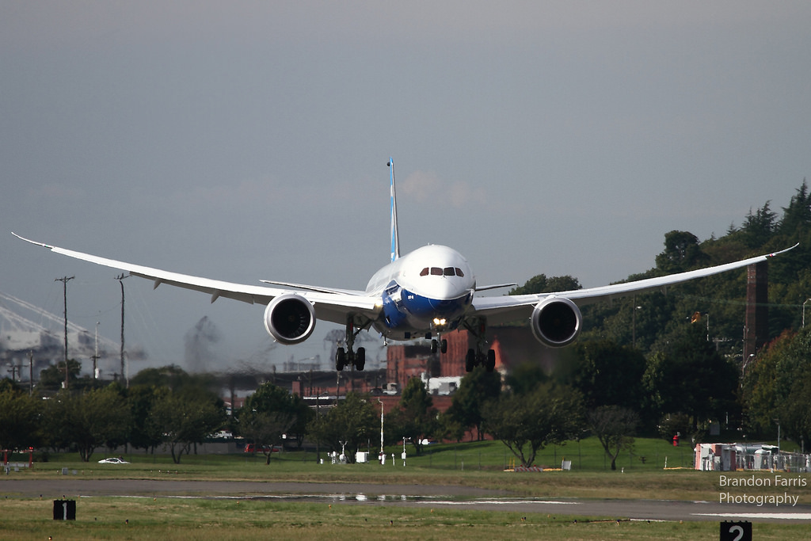
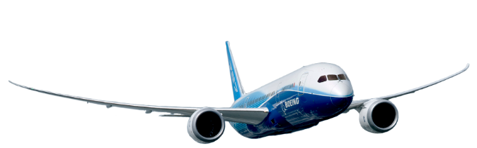
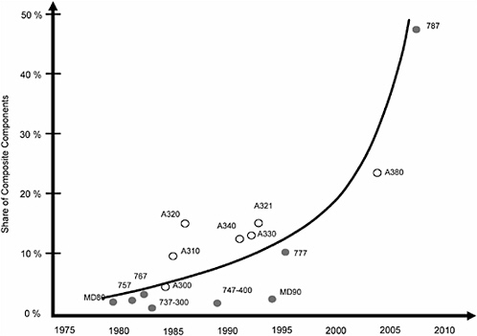
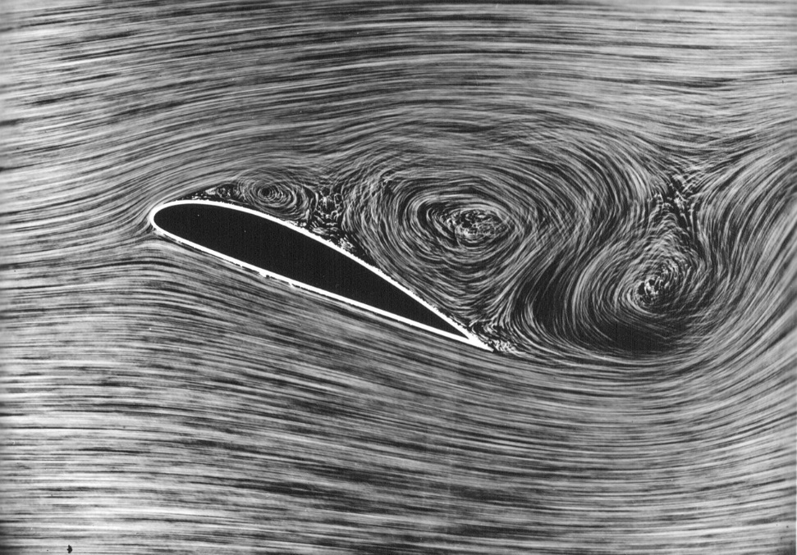
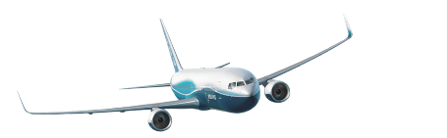

Background and Motivation
Aviation industry moving toward composite materials
Composite wing structures allow for higher aspect ratio, flexible wings
https://www.flickr.com/photos/seahawks7757/9995020466/
https://en.wikipedia.org/wiki/Flow_separation#/media/File:1915ca_abger_fluegel_(cropped_and_mirrored).jpg
https://www.nap.edu/read/11424/chapter/3

Slide 3
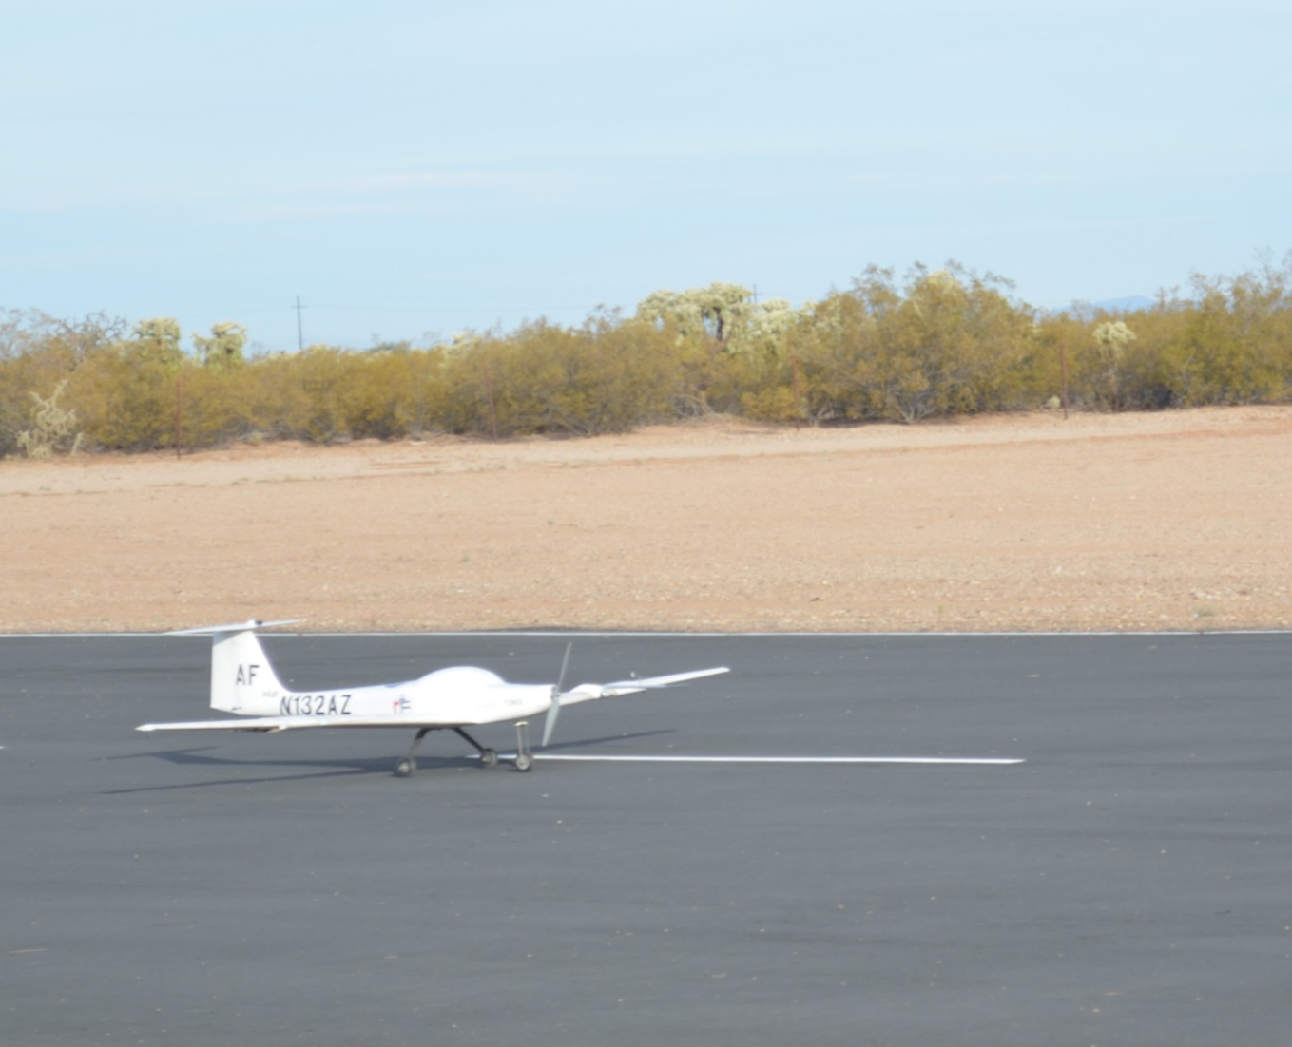
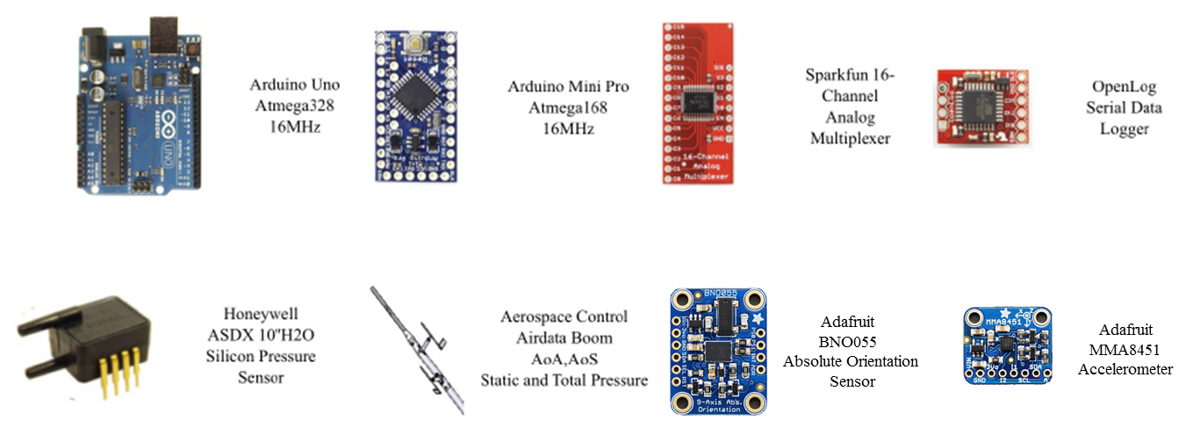
Flight Test Vehicle/Instrumentation
Unmanned 1/5 Scale Aeromat AMT-200 Super Ximango

Slide 4
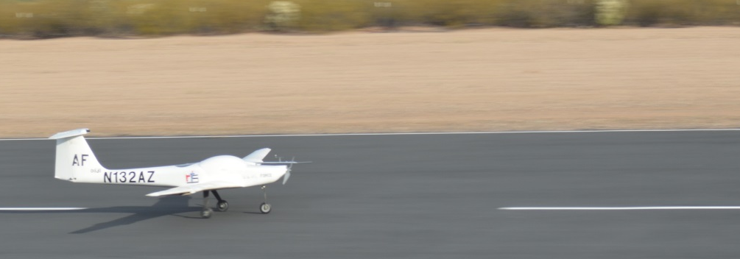
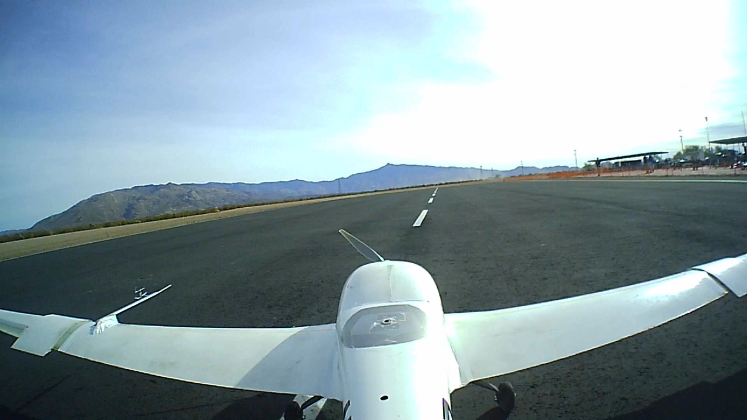
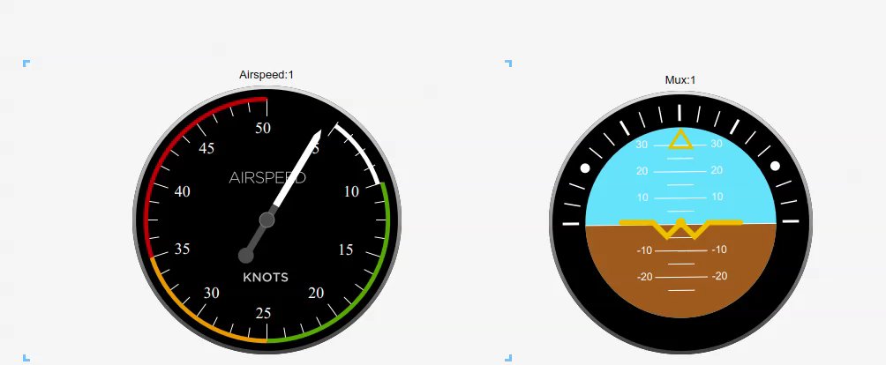
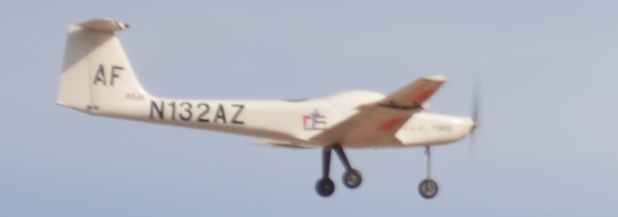
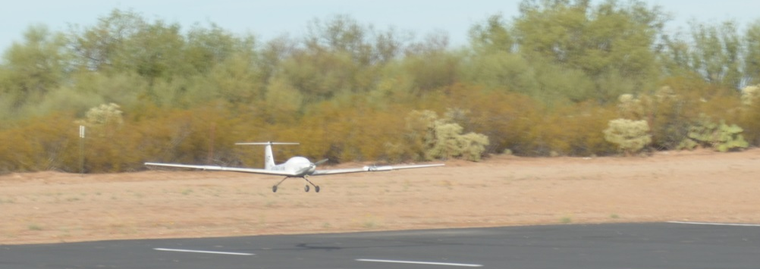
Free Flight Experiments
Initial flight test successfully completed November 12th, 2017
Low Speed Maneuver

Slide 5
Free Stream Turbulence Intensity Calculations
Proposed System: Hot Wire Anemometry with MiniCTA and custom power
Wind tunnel experiments conducted to validate system performance against accepted methods

Slide 6
Conclusions and Future Work
Baseline free flight test provided validated sensors
Proposed system (MiniCTA) for capturing turbulence intensity in flight will provide accurate results
Completion of initial tests allows for aircraft integration to capture freestream turbulence in flight

Slide 7


Acknowledgements
U.S. Air Force Office of Scientific Research (FA9550-14-1-0184)
Dr. Jesse Little
Dr. Hermann F. Fasel
Mark Agate, Doctoral Student
The Department of Aerospace and Mechanical Engineering at the University of Arizona
Arizona-NASA Space Grant Consortium

Slide 8
Thank You

Slide 9
References
[1] LockheedMartin, “X-56A - Lockheed Martin," 2015, 18 Dec. 2015.
[2] Diancs, J., Ohno, Duncan., Fuggmann, S., Lay, Jonas., Heim, D., Fasel, H. (2014). “Numerical and experimental Wind Tunnel and Flight Testing of Active Flow Control for Modified NACA 64₃-618 Airfoil”. AIAA SciTech, Kissimmee, FL.
Hosseinverdi, S. and Fasel, H.. "Direct Numerical Simulations of Laminar-to-Turbulent Transition in Laminar Separation Bubbles in Three-Dimensional Boundary-Layer", 46th AIAA Fluid Dynamics Conference, AIAA AVIATION Forum, (AIAA 2016-3793)
Mertens, C., Pineda, S., Agate, M., Little, J., Fasel, H., and Gross, A., “Effects of Structural Motion on the Aerodynamics of the X-56A Airfoil," AIAA SciTech, San Diego, California, USA, 2016. (AIAA 2016-2073).

Slide 10
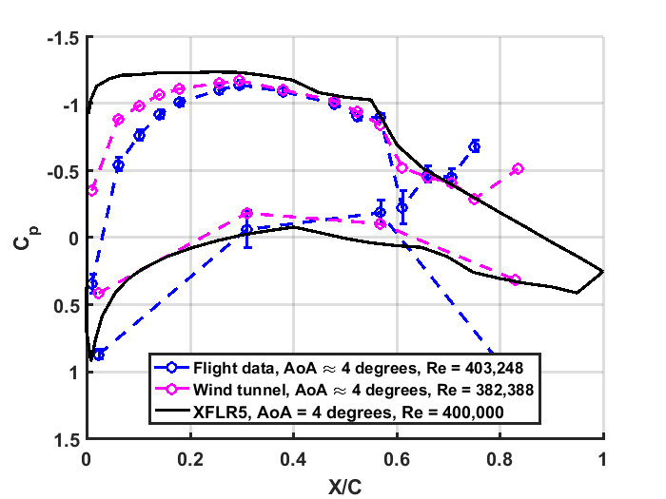
Free Flight Coefficient of Pressure

Slide 11
Hot Wire Frequency Spectra

Slide 12
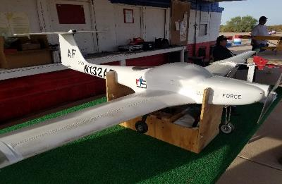
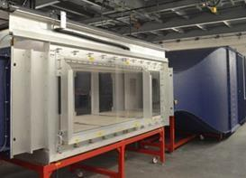
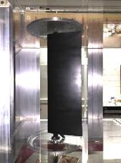
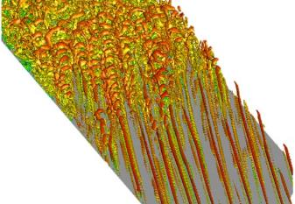
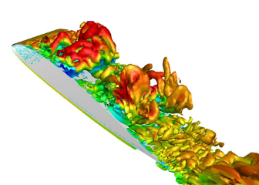
Multi-Dimensional Research Approach
Ximango 1/5 Scale
X-56A 1/3 scale
X56A: 1/3 scale
Scientifically instrumented scaled flight experiments
Wind tunnel experiments
Simulations & Theory & Experiments
Modal decomposition (Fourier, POD, DMD)
Linear Stability Theory, etc.
Detailed simulations of flow physics for relevant model problems
Simulations for entire wing sections undergoing typical structural motion
Hosseinverdi, et al.
Gross, et al.

